Slide 1
IS Efforts Supporting Our Partners HealthCare Strategies
Jim Noga, VP & CIO Partners HealthCare
June, 2014

Slide 2
Agenda
About Partners HealthCare
A Changing Healthcare Landscape
Key Themes from Partners Strategy
Aligning IT Solutions with Partners Strategies
  Partners eCare
  Patient and Referring Physician Portals
  Enterprise Data Warehousing
  Population Health Management Tools
  IT Integration Readiness
IT Transformation & FY15 “Must Dos”
Making it Happen – A Piece of Cake !!

Slide 3
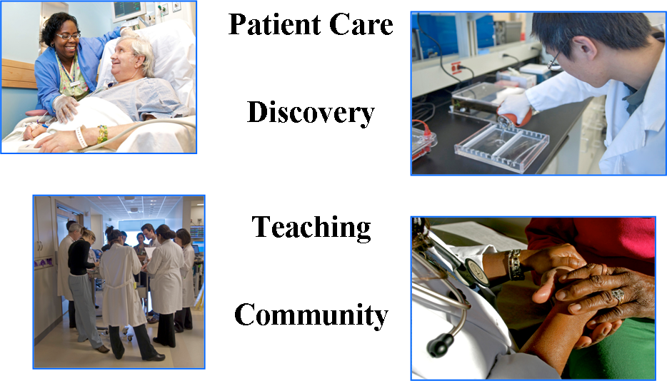
Our Mission
Patient Care
Discovery
Teaching
Community
3
Notes:
3
3

Slide 4
About Partners HealthCare
Integrated academic health care system founded by Massachusetts General Hospital and Brigham and Women’s Hospital in 1994
Largest private employer in Massachusetts
  Over 60,000 employees
Patient Care
Sickest and most complex patients
Providing essential services
Caring for the most vulnerable
Discovery
Over $1.6B in research funding
Discovering new treatments and cures
Testing new care delivery models
Teaching
100+ accredited physician residency and fellowship programs
Over 1,000 residents annually
Community
$186M in community benefits
5 owned, 16 affiliated CHCs
Over 100,000 Medicaid and uninsured patients annually
Creating economic opportunity
4

Slide 5

Full Continuum of Care
Post Acute Care
Specialty Care
Primary Care
Acute Care
2 Academic Medical Centers
5 Community Hospitals
4 Rehab Hospitals
2 Skilled Nursing Facilities
Home Health Agency
1,200 Primary Care Physicians
5 Community Health Centers
Psychiatric Hospital
Pediatrics
5
5
5

Slide 6












Our Member Institutions
*
6
*Joint Venture

Slide 7
A Changing Healthcare Landscape
Yesterday’s healthcare |  | Today’s healthcare
Care built around the institution |  | Care built around the patient
Payments incent more care |  | Payments incent better care
Responsible for immediate outcome |  | Responsible for ongoing health
Grudging acceptance of cost |  | Unable to sustain cost burden

Slide 8
Key Themes We’re Hearing
Aligning Information System Initiatives
Partners eCare
Patient Portal
Referring Physician Portal
Enterprise Data Warehousing
Population Health Tools
IT Integration Readiness
Population Health
Manage populations of patients across time and across settings
Referral Business
Provide high value episodic care for patients referred by other providers
Network Composition
Anticipate changes in the Partners network composition and relationships
Clinical and Business Intelligence
Provide data and information to navigate during the clinical transformation
Cost Management
Keep costs in check

Slide 9
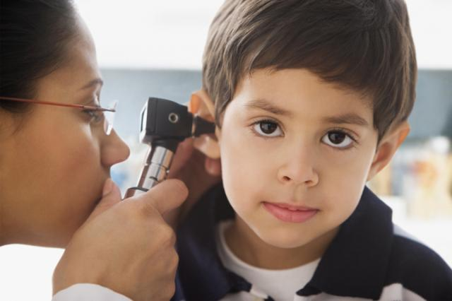
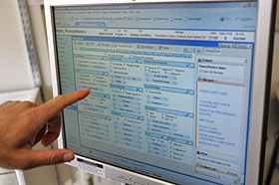

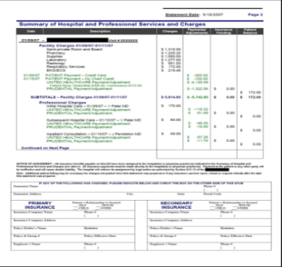
About Partners eCare
One Patient, One Record, One Team,
One Partners Statement
Partners HealthCare is working with Epic, the leading provider of health IT, to develop and implement an integrated electronic health and administrative information system across Partners by 2017
Partners eCare is the largest program of its kind in the history of Partners HealthCare
Partners eCare will serve as the foundation for new care models that Partners HealthCare is pioneering today

Slide 10

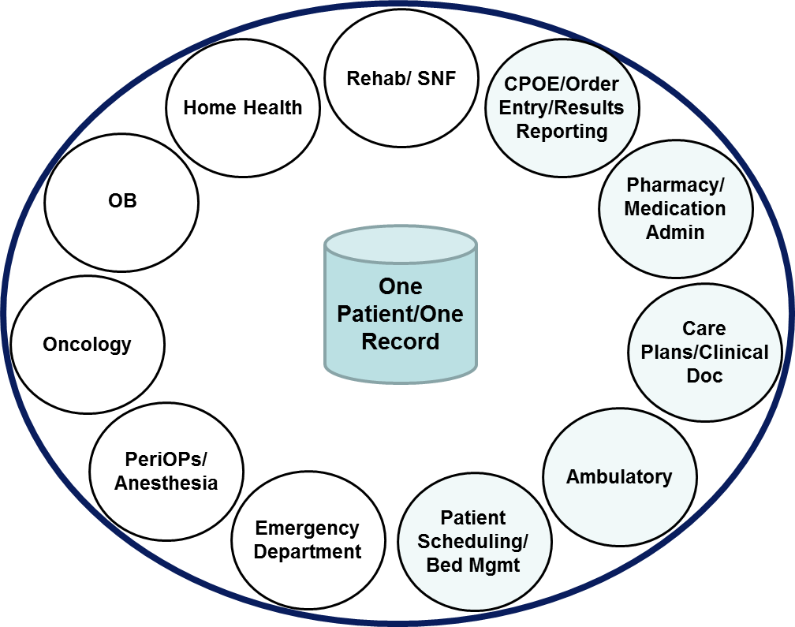
Project Scope
A fully integrated clinical system across the enterprise
FH
NE SNF
WR SNF
SSH
BWH
DFCI
McLean
SRH
Ambulatory
NWH
NSMC
HHS
CDH
MGH
MVH
NCH
Home
Care
MEEI
5,100 Physicians
8,500
Nurses
9,400
Healthcare Professionals
5,700,000 Patients
10

Slide 11
Objectives
Clinical & Patient Focus
Maintain a balance between clinical objectives and clinician and patient experience to support more integrated, efficient, and coordinated patient-centered care across the continuum of care
Clinical Ownership
Clinicians must lead the implementation, with support from IT
Standardization
Seamless, standardized clinician and patient experience governed through strong standards and oversight with input from the entities
System Integration
An integrated suite of applications is strongly preferred even if functionality for some individual components is not the best in class; an application will suffice if it meets 80% of needs
Innovation & Agility
Our future clinical system platform must be open and extensible; it will provide us with the ability to ‘innovate around the edges’ and support all of our missions
Urgency
Time to implementation must be fast to meet the needs of Care Redesign, Partners’ Strategy, and Healthcare Reform

Slide 12
Critical Path

Slide 13
Scope of Work Group 1: A Look at the Numbers
Testing
40 Cycles of Testing Enterprise-Wide
Over 100 User Participants
260 Integrated Tests
Cutover
415 Command Center Resources at peak
50 Downtime Timelines
684 Epic Go-Live Resources
Conversion
~61 million Automated Conversion Items
20,000 Manual Conversion Items
10+ Teams Involved
Content
24,000 recorded SME Hours
Flowsheets, orders, protocols, clinical decision support build
Org-Readiness
15 Clinician Engagement Webinars
~500 PeC “Test Drives”
35 Workflow Dress Rehearsals
13 Site Readiness Sessions
Training
16000 Users Assigned
Over 10 Daily Reports
98 trainers
150+ Courses
Integration
167 Interfaces
1500+ Biomed devices mapped
Facilities
5 Training Shuttles
35 Training Rooms
1000 New Network Printers
13000+ Workstations Mapped/In Testing

Slide 14
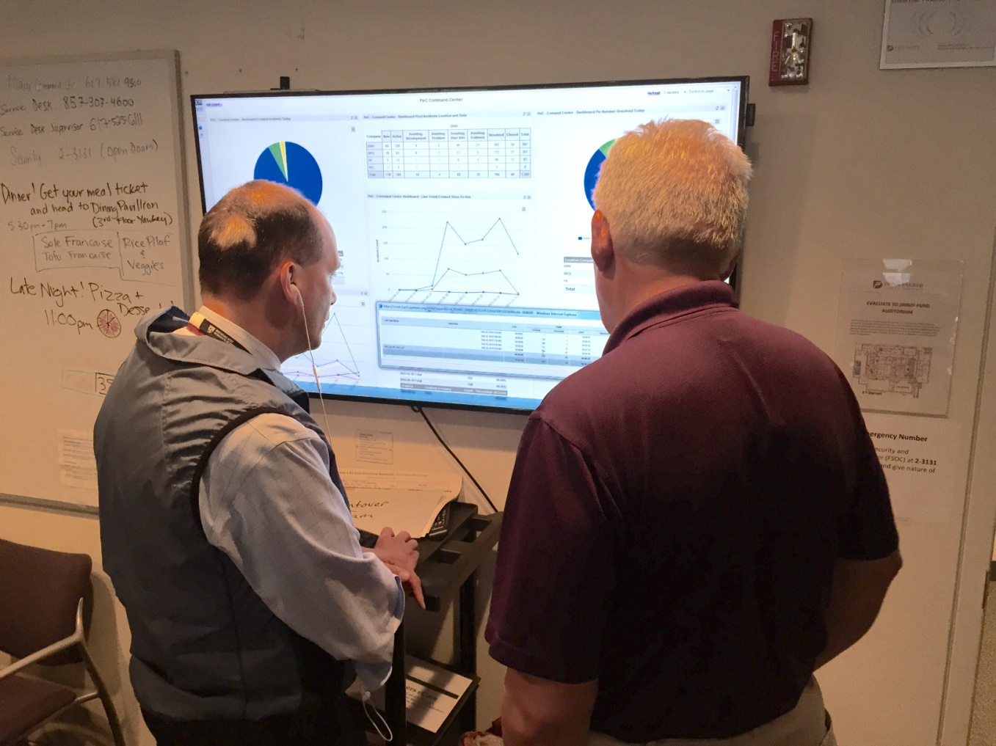

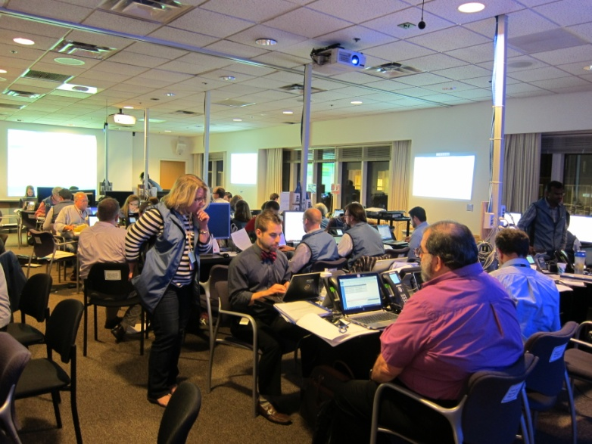
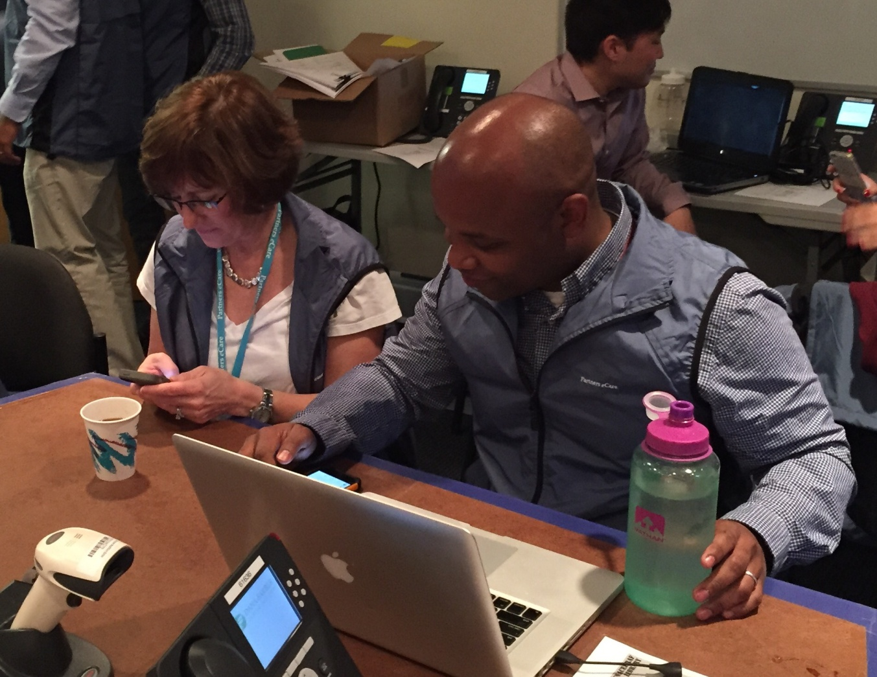
Group 1 Go-Live Command Center

Slide 15
Implementation Accomplishments
System is stable
100% of Documentation now electronic
Inpatient providers are able to see the services provided by ambulatory providers
CareEverywhere and MyChart are being utilized enhancing the experience for referral sources and patients
Home Care is functioning well

Slide 16
Go-Live Metrics Monitoring Dashboard
BWH Weeks 1 and 2
At or Better Than Target | ✓
Off Target | 
Status | Trend | Issue / Risk | Next Action / Resolution
G |  | Some reports not ready in Epic production environment | Continue to work with reporting team to finalize reports
Area | Metric | Baseline | Go Live Week 1 Data is from: |  |  |  |  |  | Go Live Week 2 Data is from: |  |  |  |  |  |  | Target
 |  |  | 6/1 | 6/2 | 6/3 | 6/4 | 6/5 | 6/6 | 6/7 | 6/8 | 6/9 | 6/10 | 6/11 | 6/12 | 6/13
Cadence | Visit volume - ED | 164 (wkday 167, wkend 156) | 153 | 147 | 149 | 143 | 165 | 144 | 134 | 193 | 186 | 174 | 180 | 163 | 156 | 164 | ✓
OpTime | Surgical Case Volume | Wkday: 112 Wkend: 10 | 83 | 103 | 95 | 96 | 88 | 15 | 9 | 105 | 111 | 101 | 106 | 92 | 13 | 112 / 10 | ✓
ASAP | Arrival to Room Time | 26.3 min | 40 min | 29 min | 18 min | 17 min | 26 min | 34.5 min | 17 min | 48 min | 22 min | 21 min | 27 min | 16 min | 20 min | 26.3 min | ✓
EpicCare Inpatient | Average inpatient Discharge Time | 14:32* (2:32pm) | 15:18 (91) | 16:12 (86) | 15:40 (132) | 15:25 (140) | 15:47 (136) | 14:25 (103) | 14:04 (90) | 15:28 (117) | 15:07 (117) | 14:54 (128) | 14:52 (138) | 14:42 (143) | 15:20 (124) | 14:32 (2:32 pm) | ✓
Cupid | Cardiac Catheterization Procedure Volume | 16.4 (avg. wkday procedure volume) | -- | 12 | 9 | 15 | 16 | 2 | 0 | 14 | 16 | 14 | 12 | 25 | 3 | 16.4 | ✓
Cupid | Non-Invasive Study Time to Close Encounter | No Baseline | 3.5 hr | 7.5 hr | 3.4 hr | 14.7 hr | 2.3 hr | 2.3 hr | 4.5 hr | 7.6 hr | 5.6 hr | 10.6 hr | 12 hr | 12 hr | 10.5 hr |  | 

Slide 17
Technical Performance/Scalability
The PeC Technology platform is performing up to expectations with the Group 1 implementation. System availability has been 100%, with excellent end-user performance.
While we monitor and manage hundreds of variables, most of the global performance and scalability is determined by a key set of drivers.
Key drivers (e.g., user concurrency, database load, storage load, CPU, memory) have been within expected ranges in most cases.
There have been several examples where sub-optimal configurations were detected via instrumentation/analytics and remediated prior to any significant user impact.
17
Notes:
17

Slide 18
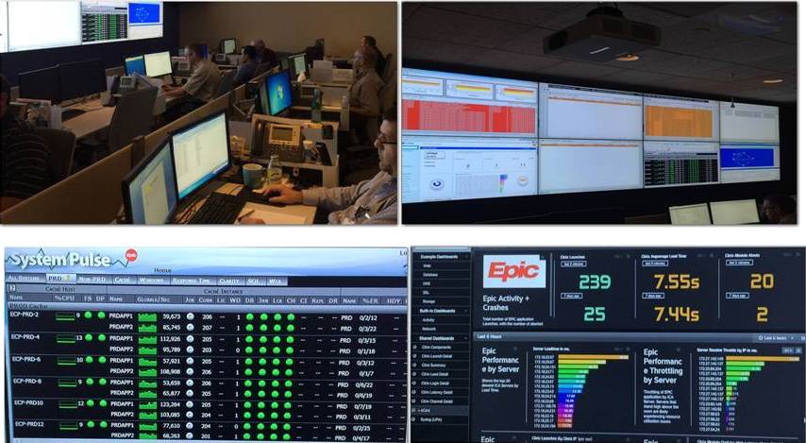
IS Operations Center

Slide 19
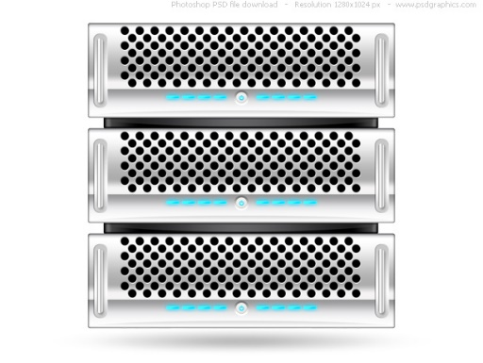
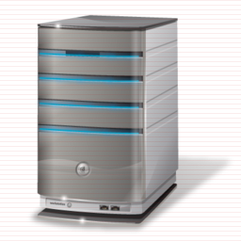

Epic – Logical Architecture
Application Execution Environment (Citrix)
Database Server (Cache)
Storage (EMC SAN)
19
Notes:
19

Slide 20
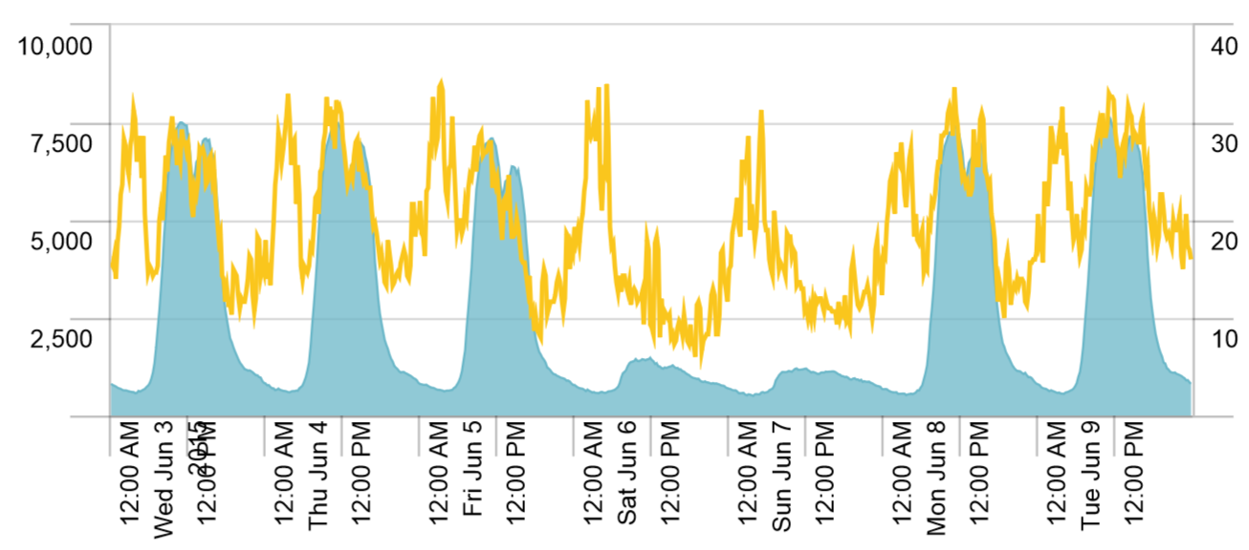
Active User Concurrency / CPU utilization
Active Users
Date
CPU Utilization
Active Users

Slide 21
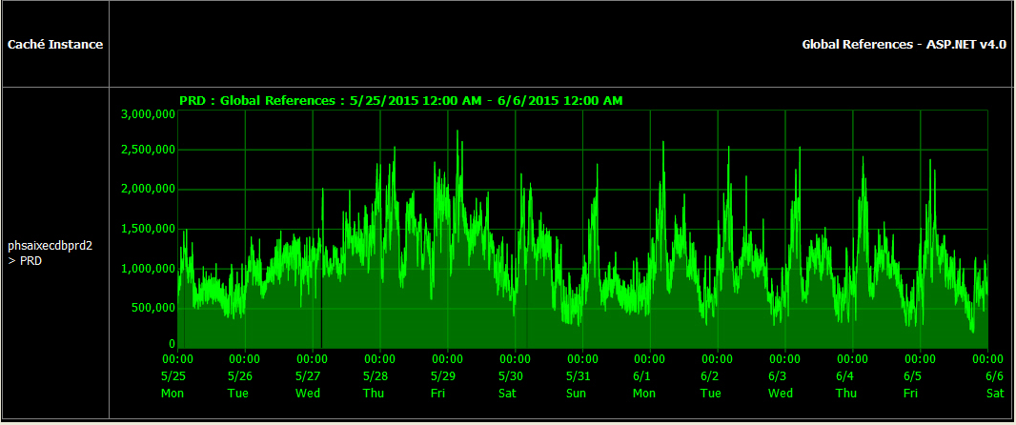
Database references (GREFs)
Peak Daily Database references as of group 1
Projected Peak Daily Database references at full implementation
Current capacity

Slide 22
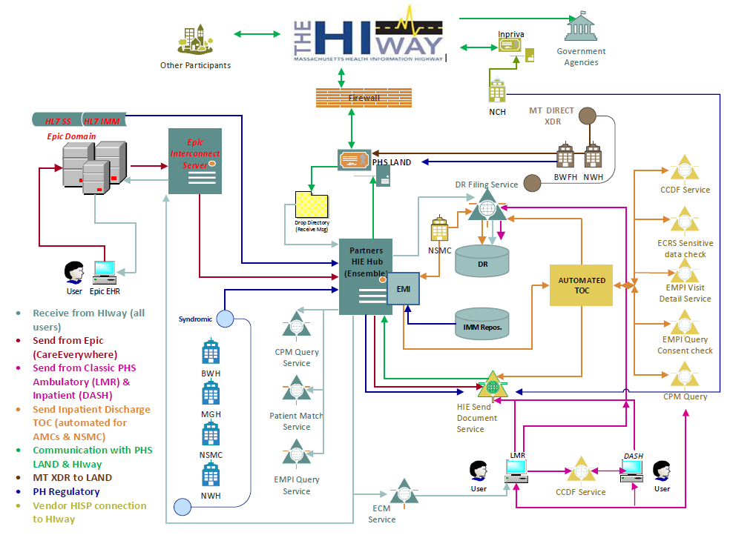
Epic – Hub – Mass HIway Interoperability

Slide 23
Group 1Post-Live Stages and Target Criteria
Target Criteria
Phase 0
Implementation
Cutover night and pre/post conversions complete
Command Center operational including meetings and communications
ServiceNow and issue/triage resolution processes kicked off
Baseline go-live metrics defined and established by sites
Phase 1
Stabilization
Command
Center Operations
All expected Epic modules live
ServiceNow tickets hit peak and begin to trend down
High volume/risk dashboard tracking issues in defined areas
Go-live metrics tracking by day in place & monitored by sites
5/25/15 to 6/26/15
Agreement by PeC and sites to close Command Center
Initial trend to close more ServiceNow tickets vs newly opened tickets
Agreed upon manageable number of Priority 1 tickets
Manageable risks/on track for all areas on high vol/risk dashboard
Go-live metrics by site achieve week 2 targets and KPI tracking in place
Revenue tracking and management processes in place
Initial local governance in place
Phase 2
Stabilization
Transition to Operations
Phase 3
Stabilization
Transition to Optimization
Capacity exists for additional demand beyond break-fix
Tracking and evaluation of ongoing Key Performance Indicators
Operations model team and implementation team positioned to address optimizations in the context of the ongoing implementation timeline
6/27/15 to XX

Slide 24
Partners eCare Next Steps
Continue stabilization of BWHC/DFCI/PHH
Continue resolution of high priority items
Prepare for transition to ongoing operations model when appropriate
Focus on Group 2 activities

Slide 25
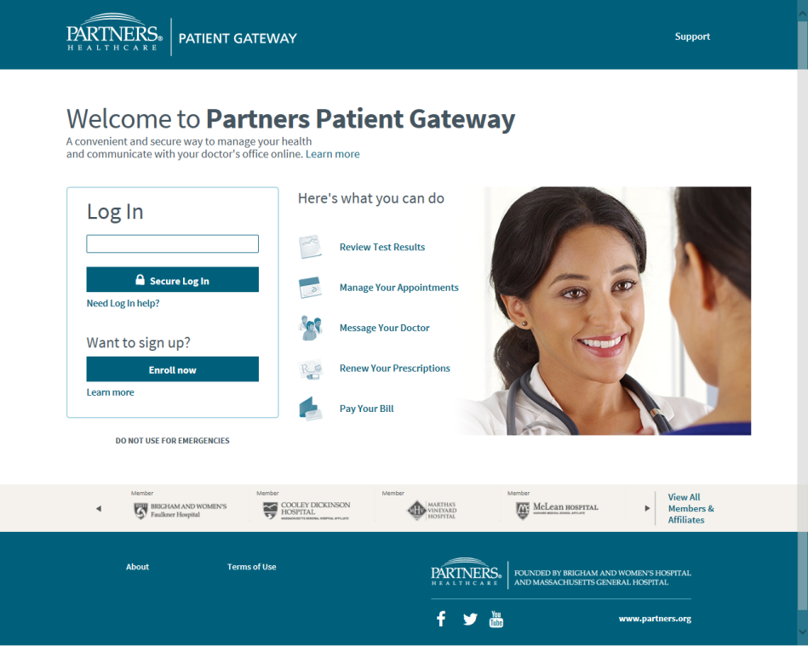
Patient Portals
Online tools to help patients
  Interact with
  their providers
  Access their
  medical record
  Access a library
  of health information
Key patient care technology
  Reduce the cost of patient interactions
  Increase patient self-management and engagement

Slide 26
Patient Portal Adoption by Providers
Partners Providers Offering a Patient Portal
Notes:
Driven by internal goal setting linked to physician incentives

Slide 27
Growth in Patient Gateway User Accounts
Data as of 12/31 of each year; 2015 YTD as of 6/19
Notes:
Estimated 40% penetration overall and higher within primary care practices (~70%).

Slide 28
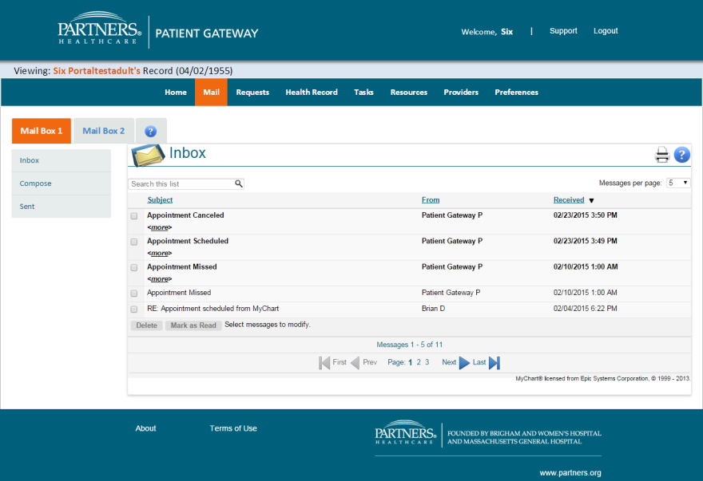
Transitioning the Portal
Challenges
  How to transition 500,000 users to Partners eCare without disruption?
  What do we offer the patient who has a doctors on the legacy EHR and Epic? Two solutions? One solution with a mix of features?
  How do we incorporate features from other Partners groups?
Strategy
  Build a portal framework or superstructure
    To manage login and authentication
    With conditional logic to handle Epic/LMR blends
    Displays menus and manages navigation
  MyChart and Patient Gateway features “play” in the framework
  Other Partners groups can build features to play in the framework
Notes:
Status – Transition underway. As of June 2015, 40% of portal users are seeing a mixed of MyChart and Patient Gateway features.

Slide 29
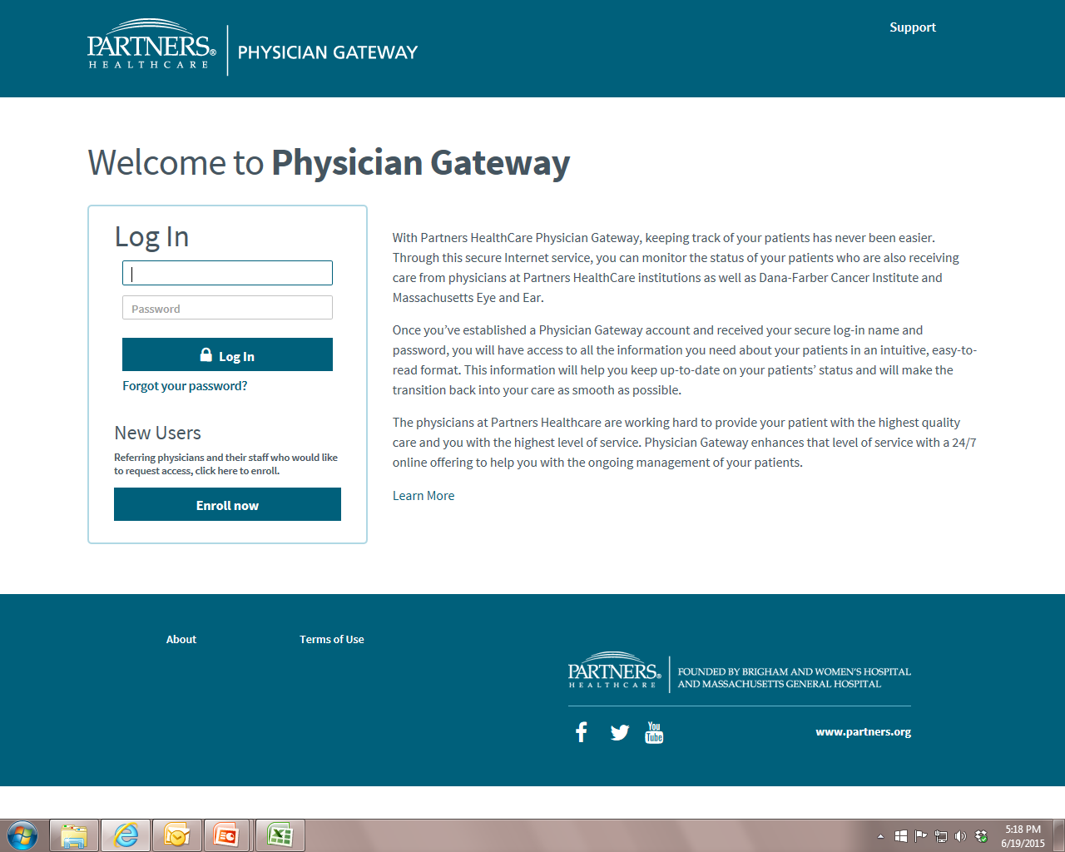
29
29
Notes:
We believe Physician Gateway is an important tool to improve the service we provide to referring physicians.
Please encourage your referral sources to consider Physician Gateway.
Thanks.
29

Slide 30
Physician Gateway
30
An online information service for physicians who refer patients to Partners HealthCare
Includes access to various types of health information
  Consult notes
  Radiology reports
  Discharge summaries
  Medications
  Allergies
  Test results
  Visit history
  Providers of care
Also, notification of admission and discharge events
Currently more than 2,000 active referring physician users
Notes:
30
Physician Gateway was developed to offer referring physicians online access to their patients’ information.
The service also includes notification of their patient’s admission and discharge events.
The service is delivered as a secure Internet application, and has features to ensure patient privacy.

Slide 31
Enterprise Data Warehousing: Goals
Marketplace dynamics are increasing the demand on Partners to understand its patient care business and drive improvements that will increase the value of that care to purchasers of healthcare, patients and their families
To enable this analysis of current performance and drive clinical transformation, Partners must establish
  a repository of clinical, administrative and financial data
  tools to manage and query this data
  services to assist users in their understanding of the data and use of the tools, and
  governance, policies and decision-making to ensure responsiveness, privacy and information security

Slide 32
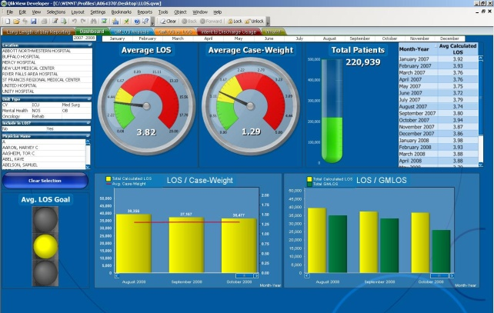
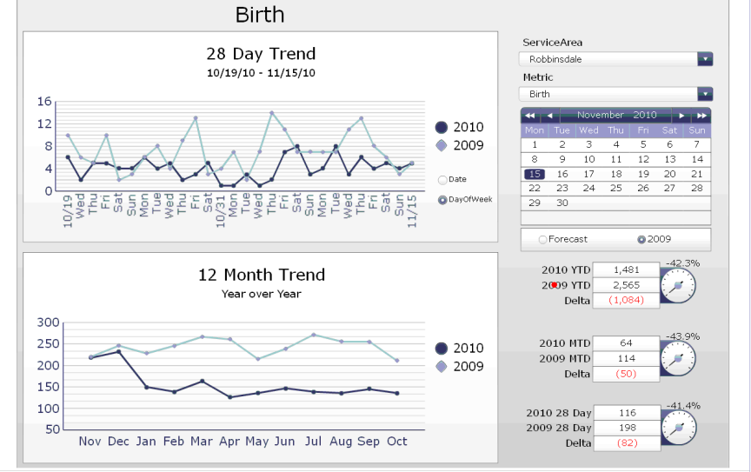
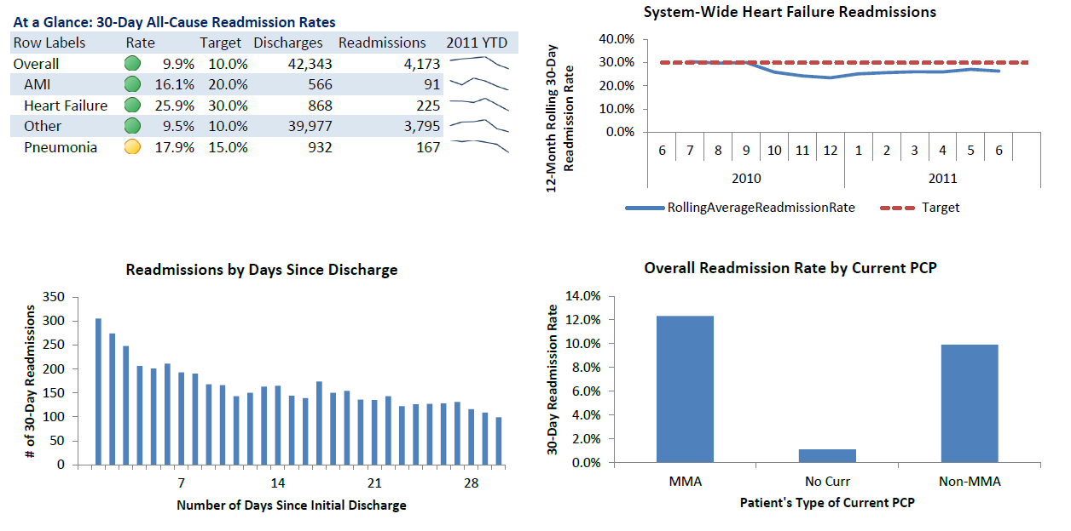
Partners Enterprise Data Warehouse
Metadata, Security and Auditing
Enterprise Master Patient Index (EMPI)
Common, Linkable Identifiers
(Pat, Prov, Loc)
Corporate Provider Master (CPM)
INTERNAL
SYSTEMS
Integrated Marts
(Lab, DX, PX, RX, Encounter)
EPSi
Pat Fin
Source Mart
Clinical
Source Mart
Legacy Clinical Systems
Legacy Clinical Systems
Legacy Clinical Systems
Healthcare Directions
Cohort Finder
Comorbidity Analyzer
EXTERNAL
SYSTEMS
Payer
Source Mart
Episodes of Care
IDEA
CMS
Key Process Analyzer(KPA)
Harvard Pilgrim
Population Insights
IDEA – Instant Data Entry Application
Tufts Health Plan
Readmission Explorer
BCBS of MA
CAUTI
CLABSI
Others
PURCHASED
DATA
Epic
Source Mart
Misc
Epic
Other Sources
Other Sources
Other Sources
Green – Currently in Production
Red – In-Progress: Not Yet Available
Orange – Not Started
More Transformation
Less Transformation

Slide 33
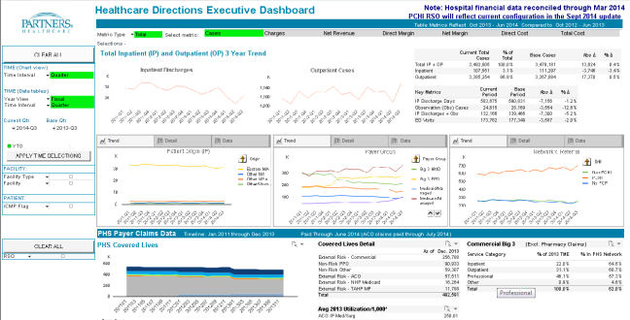
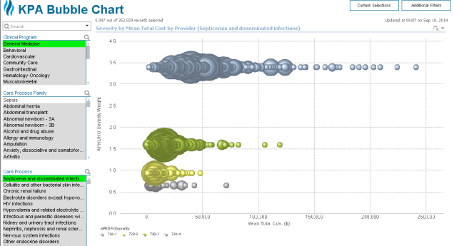
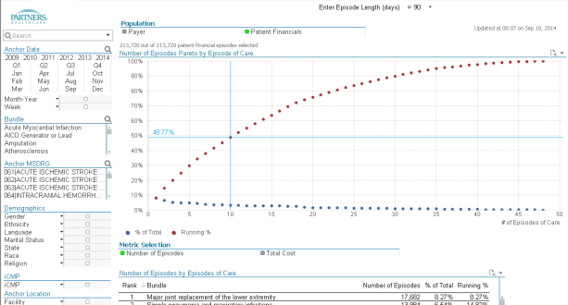
Subject Area Marts and Data Visualizations

Slide 34
Three Phases of Work for Improving Population Health
Phase 3
Phase 2
Phase 1
4
Wellness Promotion
Programs to prevent or delay the progression of illness
2
Specialty care:
Where a large fraction of costs are incurred, especially in commercial populations
Patient engagement:
Involving patients in better self-management of care
1
Primary care:
The hub for managing
populations: preventive services, chronic illness,
high risk
3
Ongoing: IS, analytics and central infrastructure
Notes:
34

Slide 35
Population Health Management IT
Primary Care
  High Risk Patient Management
    Identified high risk patients using claims data and Impact Pro
    Enhanced existing care management solutions (Mosaic and Morrisey)
    Evaluating solutions to notify users on high risk patient events
  Patient-Centered Medical Home
    Enhancing LMR to support team-based care approach
  Chronic Disease / Prevention Management
    Enhancing existing solutions (Matrix and TopCare) to identify patients with gaps in process or outcomes
IT Infrastructure
  Incorporated new claims data from local payers and CMS
  Applying analytic tools to improve our understanding of contracted populations

Slide 36
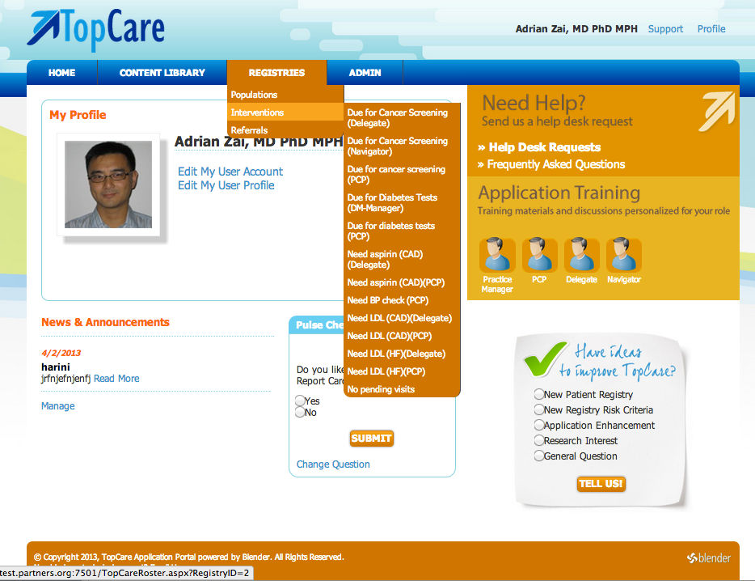
Registry landing page

Slide 37
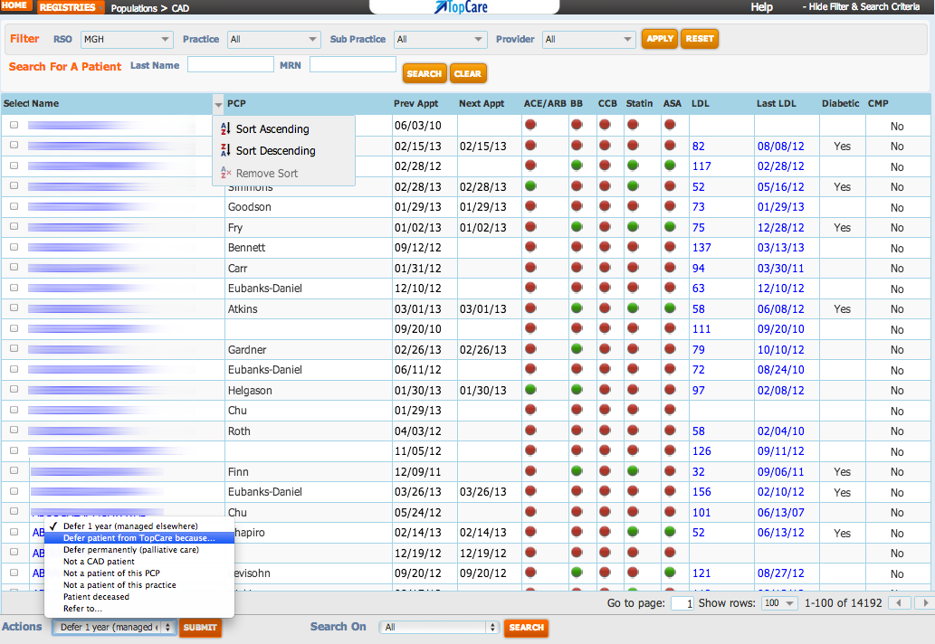
Example of CAD Population Registry

Slide 38
“Must Do” IS Priorities
Program | Accountable | Metrics
1) Partners eCare (Strategic) | Stone, Spurr, Flammini, Keogh
2) Security (Strategic) | Kadakia (Flammini, MacLean)
3) ICD -10 (Regulatory) | Stone, Spurr
4) Meaningful Use Stage 3 (Regulatory/Financial/Reputational) (Certification only) | Bero, Spurr (Babachicos, Jennings, Schroeder)
5) New Affiliate Adoption (Strategic) | Bero (Stone, MacLean, Aske, Spurr)
6) Population Management (Strategic/Financial) | Bero (Spurr, Jennings)
7) Enterprise Data Warehouse (Strategic/Foundational) | Bero (Keogh, Flammini, Stone, Daly)
8) Human Capital Development (Strategic) | Noga (MacLean, Witherell, Connors)
9) ITIL/ServiceNow Implementation (IS Leadership) | MacLean
10) IS Infrastructure (IS Leadership) (App Delivery, New Data Center, VOIP, Office 365) | MacLean , Flammini
11) Partners Data Lake (Big Data to support the research community) | Noga
Notes:
“Accountable” need to come back next IS Ops Meeting with measures (track w/ dashboard) AND this is one component of PA

Slide 39
Other IS Initiatives
Initiative | Accountable | Secondary
New Data Center Move | MacLean | Grieco
Enterprise VoIP | MacLean | White
Office 365 | MacLean | Mendoza
Server Virtualization | MacLean | Grieco
Business Continuity Support | MacLean | Raab
Document Management | MacLean | MacLean
Community Data Center Consolidation | MacLean | Grieco
Assembly Row Technology Planning | MacLean | Marra
Thin Client Application Delivery | Flammini | Lou
Health Information Expansion | Spurr | Rubalcaba
Legacy Data Archiving | Babachicos | Noga
Could Strategy | Flammini | MacLean
PeopleSoft Infrastructure Upgrade | Stone | Meade
Notes:
Need to re-organize this; it’s a copy

Slide 40
IT Integration Readiness Workplan
Organizational Integration
Review and reconcile the scope of IT functions
Security Assessment and Implementation
Complete security risk assessment
Develop risk mitigation work plan
Prioritize items
Infrastructure Integration
Develop a plan to integrate IT infrastructures
Communication and Collaboration
Plan for the integration of email, telecommunications, paging and document sharing.
General Financial Integration
Plan for integration of general financials and HR/Payroll systems.
Timing dependent on the security and infrastructure items
Bridging Tactics
Meet short term clinical, financial and regulatory needs through focused bridge solutions.
Patient Revenue and Clinical Systems
Plan for the transition to a single clinical and patient revenue system in collaboration with entity leadership
Population Health
Develop a plan to support integrated, population health
Health Information Exchange
Plan and implement HIE projects
Align staff to execute the plan
Prioritize work based on software projects and risk assessment
Work may be dependent on infrastructure plan
Implementation will be tied to other projects including clinical system.
HIE tools and technologies
Bridge to state and federal agencies

Slide 41
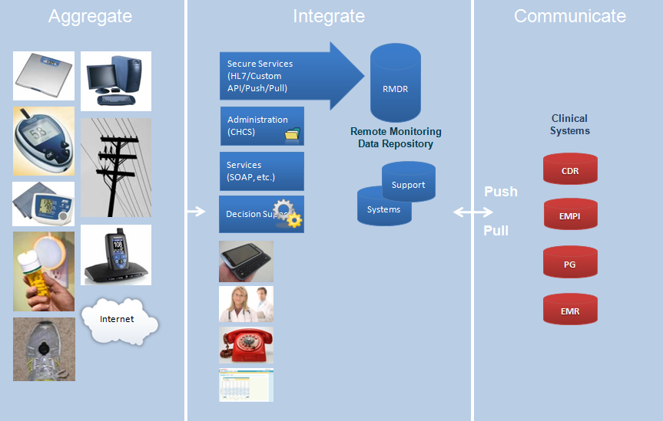
Connected Health Care Suite
Notes:
Cellular, wifi, smart phone (third parties, qualcom – 2net, lear, home link – hubs) apps that make a smart phone a hub)
Hub transmits – to hub vendors –
Remote Monitoring Data Respository
CHCS – Connected Health Care Suite (KICKS) – EMPI integration, register patients and devices, VPN tunnels and certificate, transport is secure
Services, input and extraction services - eg. PROMS

Slide 42
IT Transformation – Drive to Excellence
42
Organization
  Shared services organization
  Reduce cost and agility as an enterprise
Management
  Adoption of Information Technology Infrastructure Library – ITIL
  Alignment of business strategy
Application and Information
  “Ruthless” standardization
  Customer satisfaction, agility, and reduced cost
Infrastructure
  New IT 0perating model 20% maintenance/80% strategic initiatives
  Agile and thin provisioning
Facilities Transformation
  Availability, security, extensibility, and monitoring
  Active-Active data centers/proactively addressing potential issues
Governance
  Single IT governance model
  IT as an enterprise asset
Program Management
  Effective project and portfolio management

Slide 43
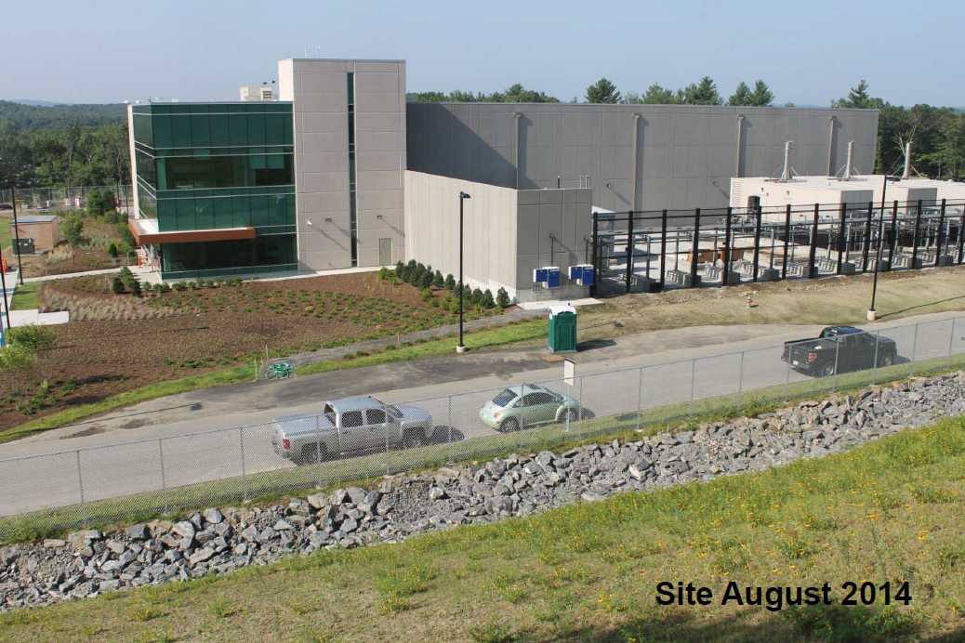
43

Slide 44

Making it Happen – A Piece of Cake !!

Slide 45

Challenges: Bring Your Own Device
Healthcare workers, like workers everywhere, want to use their personal devices on corporate networks
Devices are rapidly changing
  Smaller
  Faster
  Cheaper
  More capable
  More diverse
Offering a consistent user experience across this range of devices is challenging

Slide 46

Challenges: Information Security
Trends that make data more accessible, also increase the challenge of information security
Mobile devices
  Data on the move
  More risk of theft or loss
More data movement
  Over public networks
More regulatory oversight

Slide 47

Challenges: Big Data
The data we collect are changing
  Volume
    More data
  Velocity
    Arriving faster
  Variety
    With images, sound, unstructured text
New hardware and software technologies may be necessary to help us manage
BIG
DATA

Slide 48

Challenges: Managing Cost
Reduce waste through high reliability systems (i.e., minimize disruption)
Deliver responsive, high quality IT services (i.e., get it right the first time)
Look for greater efficiencies through increased standardization (i.e., create economies of scale)
Selective use of cloud-based offerings (i.e., leverage commodity IT)
Increase collaboration and communication (i.e., nothing lost in translation)

Slide 49
Discussion

