Slide 1
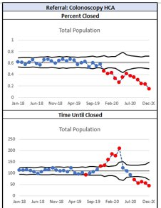
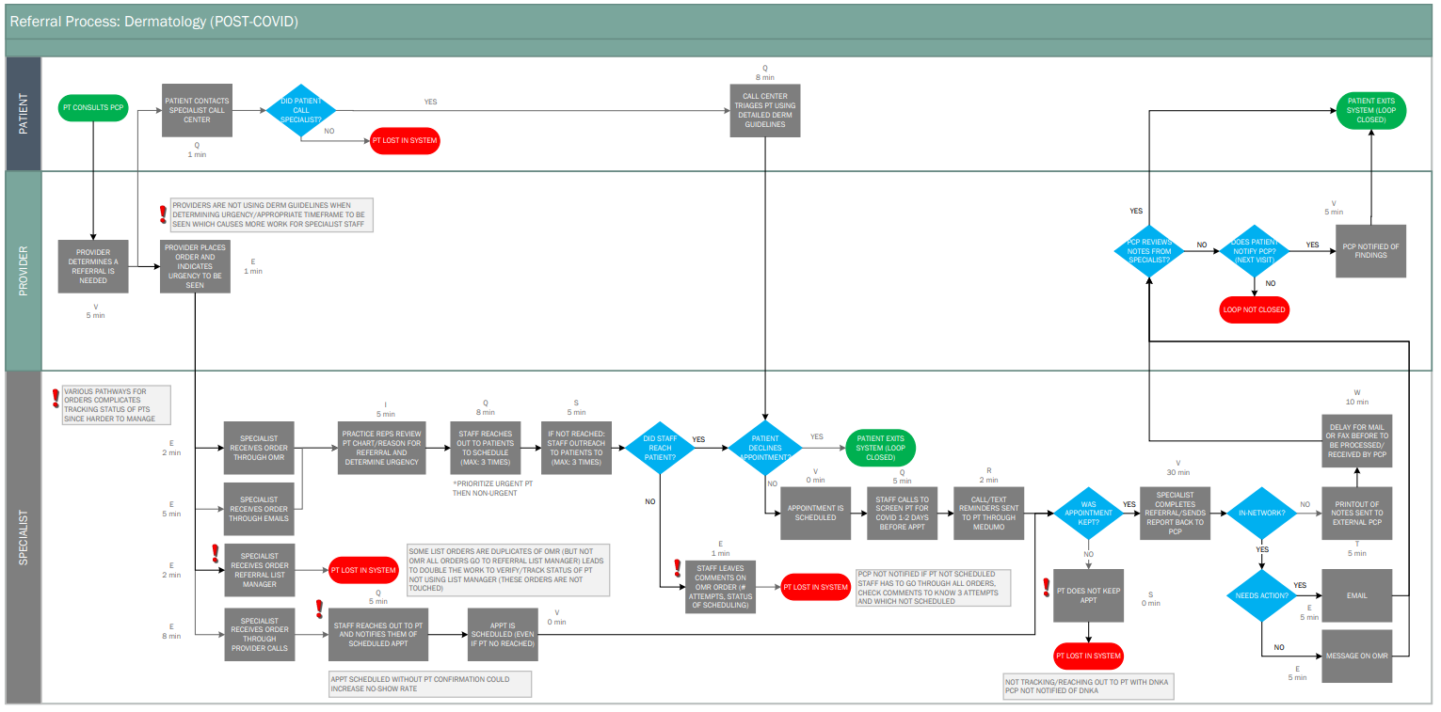
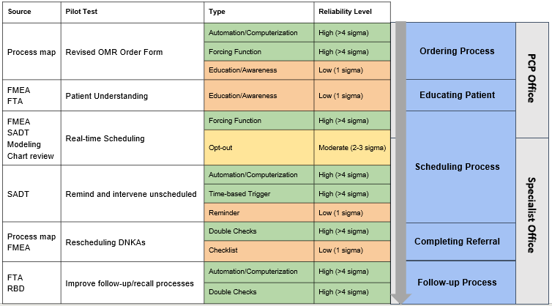
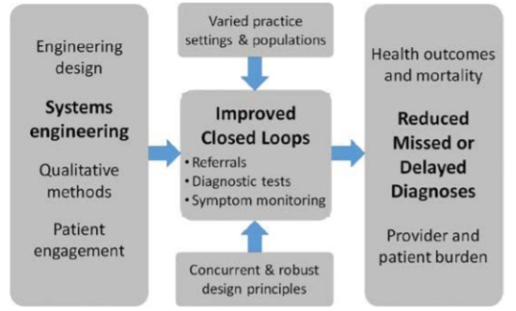
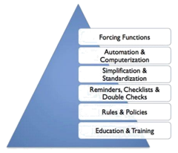
CLOSED: Closing Loops by Operationalizing Systems Engineering and Design
Nicole Nehls¹, Talya Salant², James Benneyan¹, Mark Aronson³, Scot Sternberg³, Gordon Schiff^{4,5}, Russell Phillips^{3,5}, Maria Rivera, DeeDee O’Brian, Meghan Dreilak
¹Healthcare Systems Engineering Institute, Northeastern University, ²Bowdoin Street Health Center, Beth Israel Deaconess Medical Center, ³Division of General Medicine, Beth Israel Deaconess Medical Center,
⁴Center for Patient Safety, Brigham and Women’s Hospital, ⁵Center for Primary Care, Harvard Medical School
Motivation
Results
Diagnostic errors in primary care are costly and often are due to failures to follow up (“close the loop”) on diagnostic tests, referrals, and symptoms
(1) Diagnostic tests and referrals often are not completed
(2) Tests and referral results often are not communicated to patients and PCPs
(3) PCPs frequently are not informed when symptoms evolve, altering diagnosis
Methodical systems approach to closing loops on diagnostic processes will measurably improve timely completion from approximately 70% to 90%
Loop closure rates and timeliness of loop closure varies significantly based on the department and test site
Process maps highlighted areas most susceptible to failures and in most need of intervention and extra support
Failure analyses emphasized the severity and frequency of the failures identified in the process mapping stage
Structural analysis design technique diagrams and reliability design science concepts helped facilitate process redesign brainstorming and new thinking which resulted informed potential solutions and pilot tests
SPC Charts
Process map
Rapid cycle pilot testing
Objective
Aim to reduce diagnostic errors using systems engineering methods to 1) redesign diagnostic processes in primary care and 2) develop highly reliable and generalizable, “closed loop” systems
Methods
Problem Understanding | Solution Design & Testing
Data analysis of loop closure rates Statistical process control charts Process mapping using Lean, human factors, and reliability concepts Failure Modes Effect Analysis (FMEA) Chart reviews and patient interviews Simulation modeling of “loop of loops” | Structural Analysis Design Technique Participatory patient-centered design Quality improvement and health services research approaches Process improvement and redesign Pilot testing and prototyping Simulation modeling of interventions
SADT Diagram
Lessons Learned
Conceptual Framework of Project
Reliability Science Design Pyramid
Systems engineering approaches proven useful to study complex problems and improve and redesign care processes and outcomes
Incorporated equity as a key dimension of quality optimizes the generalizability and universality of our proposed systems redesign
Integration of perspectives from patient advisors, clinicians, engineers, and staff prompts more innovation and collaboration
Important to have primary processes that prevent failures for majority (~80%) of patients and secondary processes to detect failures
Need reliable mechanisms and processes to detect and mitigate for patients with loops not closed
Higher reward with focusing efforts on upstream processes rather than further downstream processes
Need to generate more “out of the box” ideas that are still practical given constraints and priorities of system
High reliability
Low reliability

